Slide 1
Introduction to Computer System
Lecture: 1
Prepared by: Moin Khan

Slide 2
What is a Computer?
A computer is an digital electronic machine that:
Accepts data (Input)
Processes the data
Stores the data
Produces information (Output)

Slide 3
Cont.
‘’Computer is an electronic device that can accept input data, process data, store data and produce output according to set of instructions /program’’.
OR
“A computer is a smart machine that helps humans perform work quickly, accurately, and efficiently.”

Slide 4
5. Input → Process → Output Cycle
Input (Entering Password)
Process (System Verifies)
Output (Show Result)
Storage (Store/Retrieve data)

Slide 5
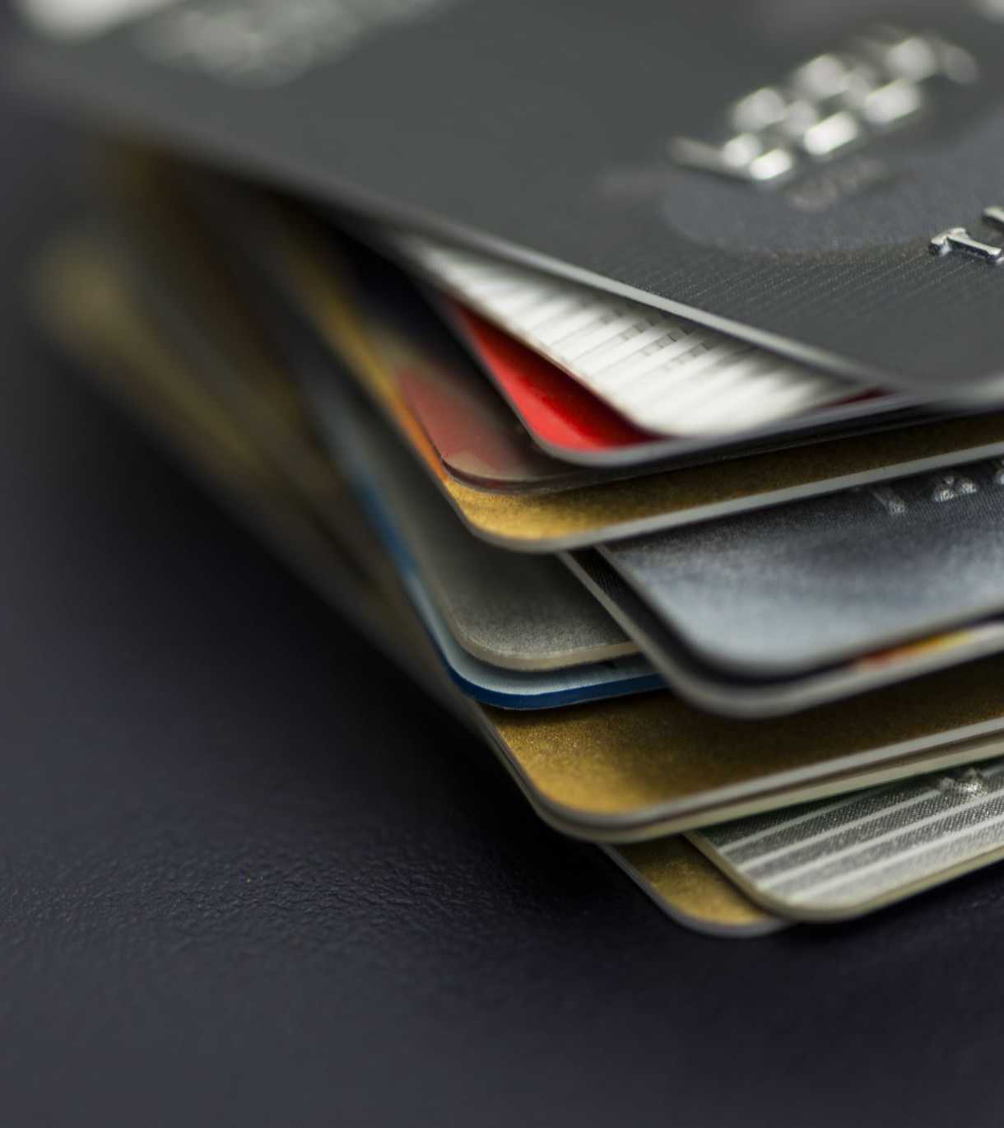
Example 1
ATM Machine
Input → Insert ATM card and PIN
Processing → Bank verifies account
Output → Cash and receipt

Slide 6
Example 2
Calculating Average
Input → Enter Student Marks
Processing → Computer calculates average
Output → Display Results

Slide 7
Why Do We Need Computers?
Before computers:
Calculations took days
Weather prediction was difficult
Records were maintained manually
Communication was slow

Slide 8
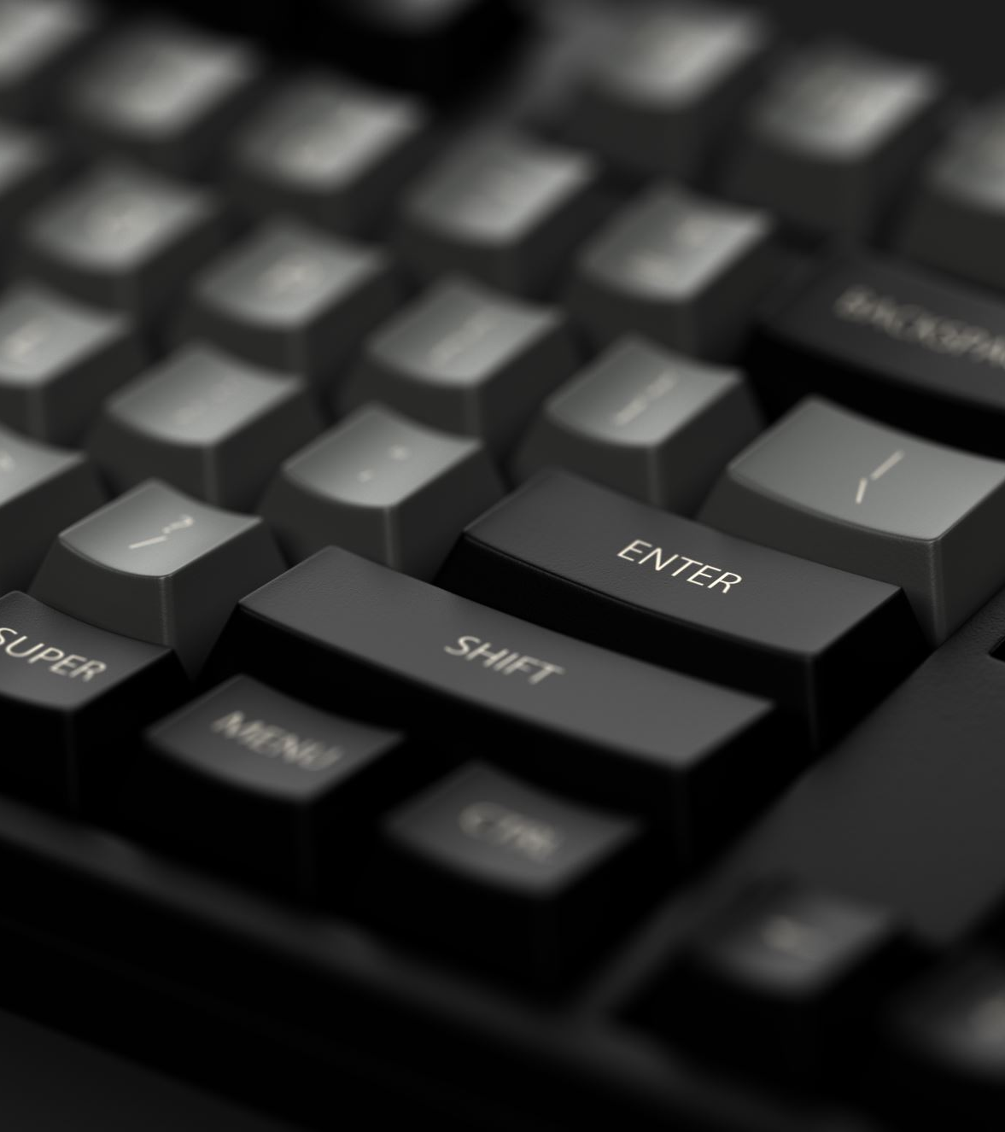
Now computers help us:
Store huge amounts of data
Perform calculations in seconds
Communicate globally
Conduct scientific research
Analyze environmental changes
Predict disasters

Slide 9
3. Characteristics of Computers
Speed
Accuracy
Storage Capacity
Automation
Reliability
Multitasking
Versatility

Slide 10
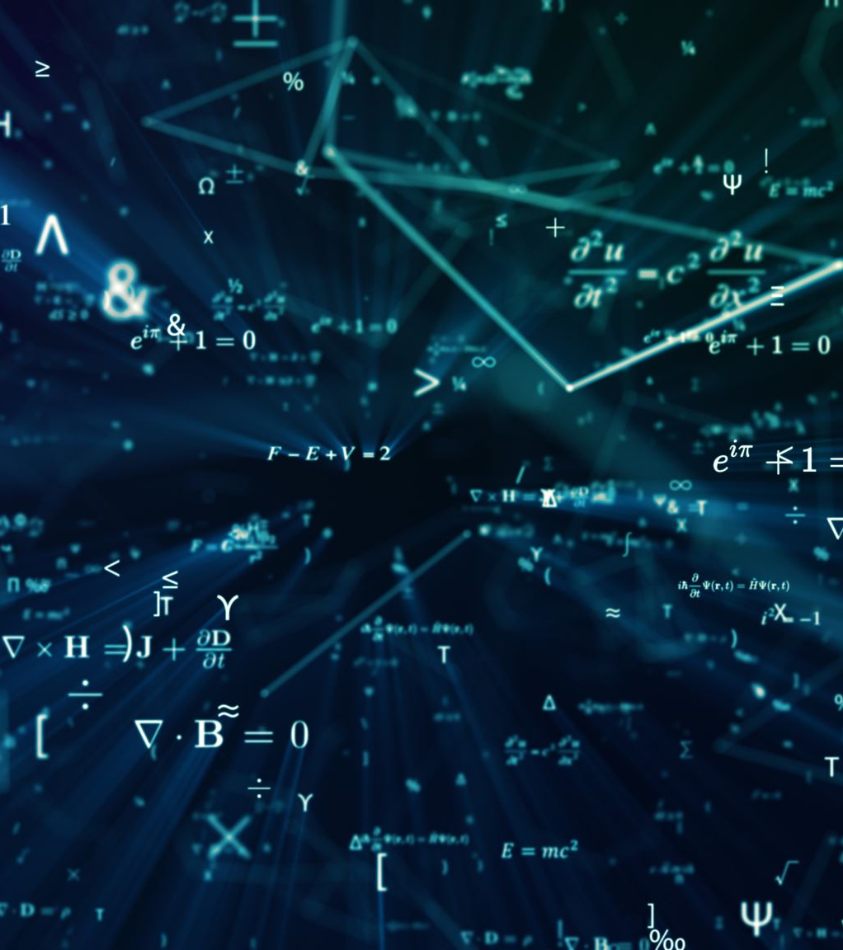
a) Speed
Computers perform millions of calculations within seconds.
Example:
Weather forecasting
Chemical calculations

Slide 11
b) Accuracy
Computers produce highly accurate results if instructions are correct.
Example:
Laboratory calculations
Scientific simulations
Errors in computer data processing is mostly human factor.

Slide 12
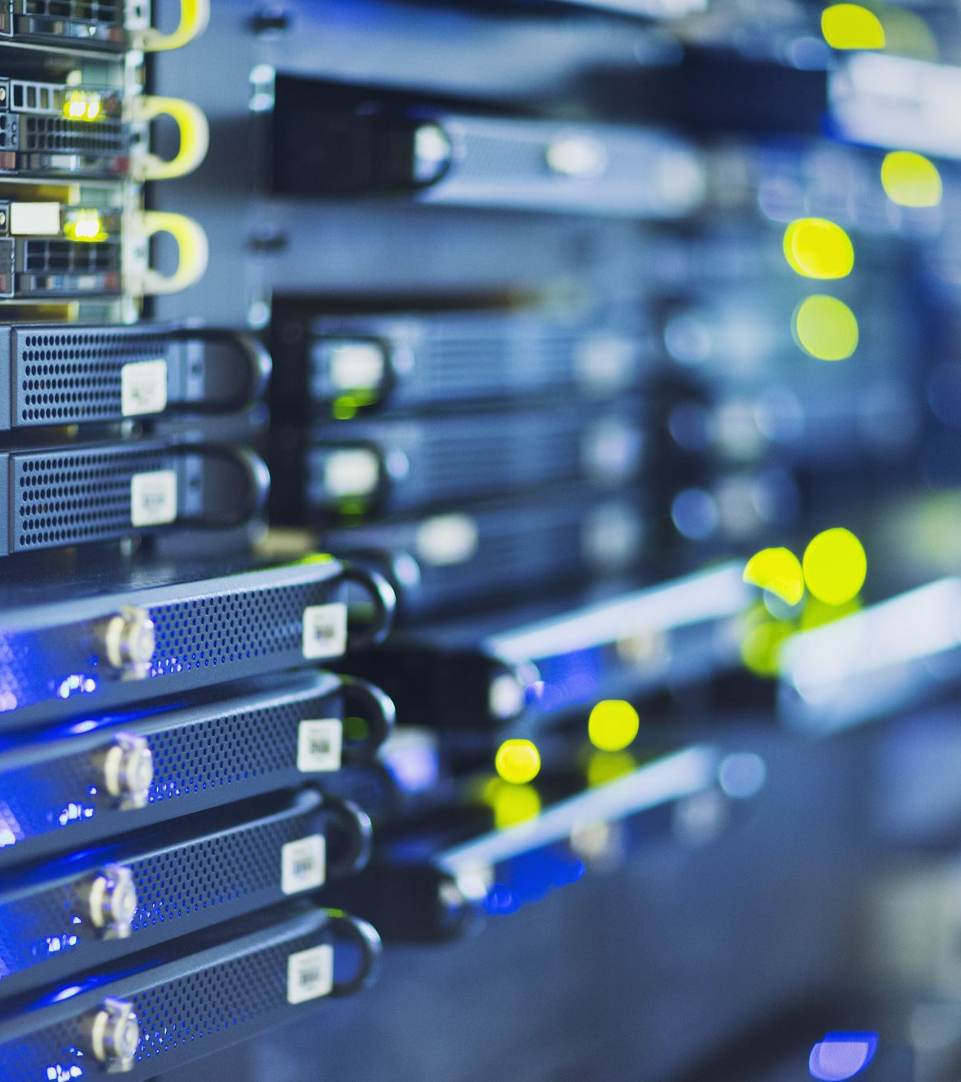
c) Storage Capacity
Computers can store huge amounts of data.
Example:
Student records
NADRA records

Slide 13
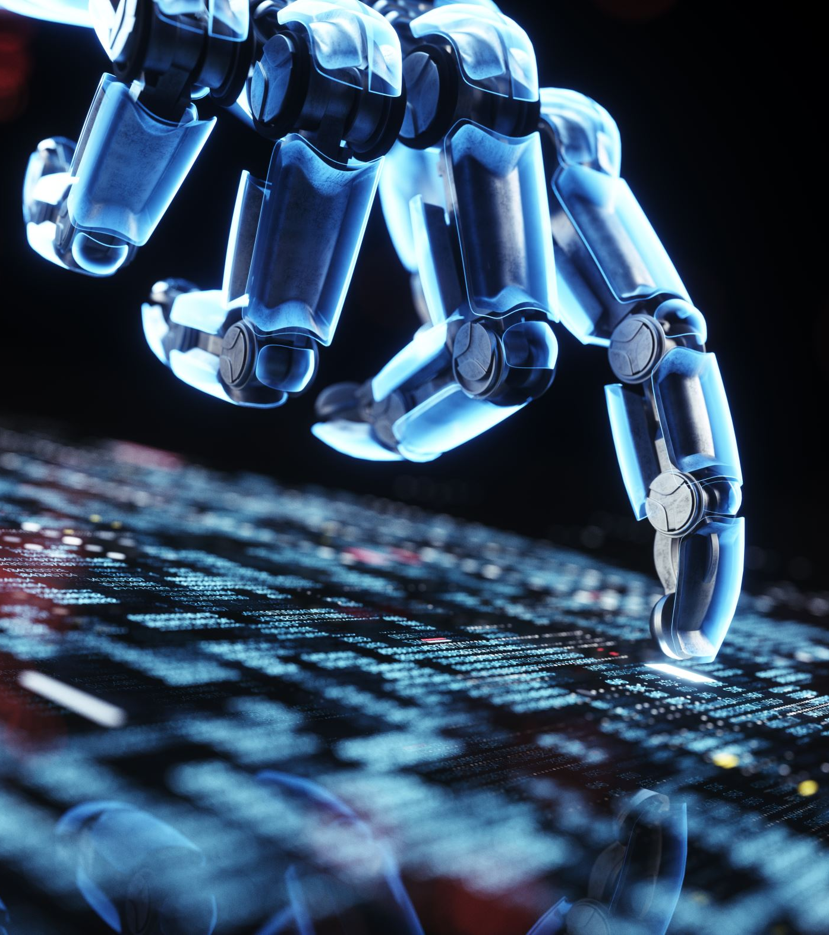
d) Automation
Computers can work automatically once instructions are given.
Example:
Phone Alarm
AI chatbots
Tesla Car

Slide 14

e) Reliability
Computers produce consistent and accurate results every time for the same set of input data.
Example:
ATM cash withdrawal
Airplane Auto-Pilot

Slide 15
f) Multitasking
A computer can perform multiple tasks simultaneously.
Example:
Playing video
Downloading files
Running software

Slide 16
g) Versatility
Computers can be programmed and applied for different purposes. People can use computers for different applications.
Hospital
Bank
Educational Organization

Slide 17
4. Basic Components of a Computer System
Hardware
Software
Data
Users
Procedures

Slide 18
a) Hardware:
Hardware refers to the physical parts of a computer that can be seen and touched.
Hardware:
Input Devices
Output Devices
Motherboard
Processing Devices
Storage Devices

Slide 19
Input Devices:
Used to enter data into the computer.
Examples:
Keyboard
Mouse
Biometric Scanner
Document Scanner
Microphone

Slide 20
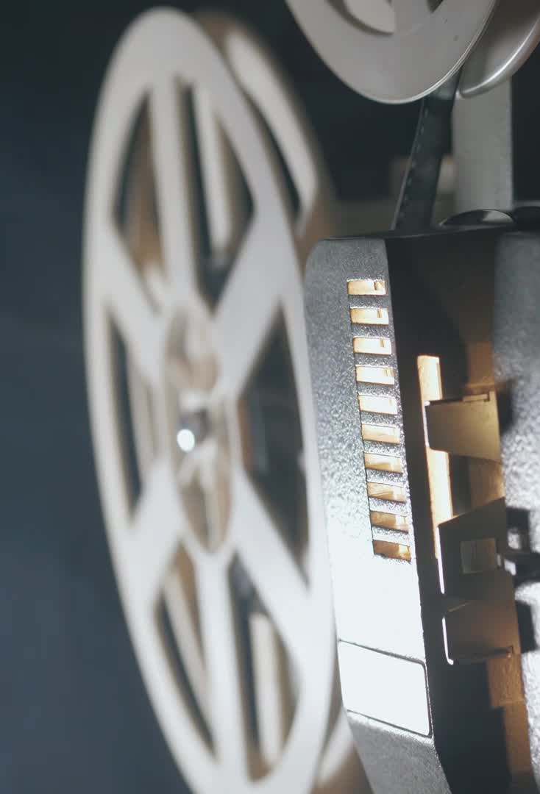
Output Devices:
Used to display results from the computer.
Examples:
Monitor
Speaker
Printer
Projector

Slide 21
Motherboard:
Main Printed circuit board of computer.
All components connects here.
Key Components on Motherboard.
CPU Socket
RAM Slots
Expansion slots
BIOS chip
Ports

Slide 22
Processing Devices:
Hardware that processes data and executes instructions.
CPU (Central Processing Unit)
Brain of Computer
ALU (Arithmetic Logic Unit)
CU (Control Unit)
Registers
GPU (Graphics Processing Unit)
Handles Images, Video, Gaming

Slide 23
Storage Devices:
Used to store information.
Examples:
Hard Disk
SSD
USB Drive

Slide 24
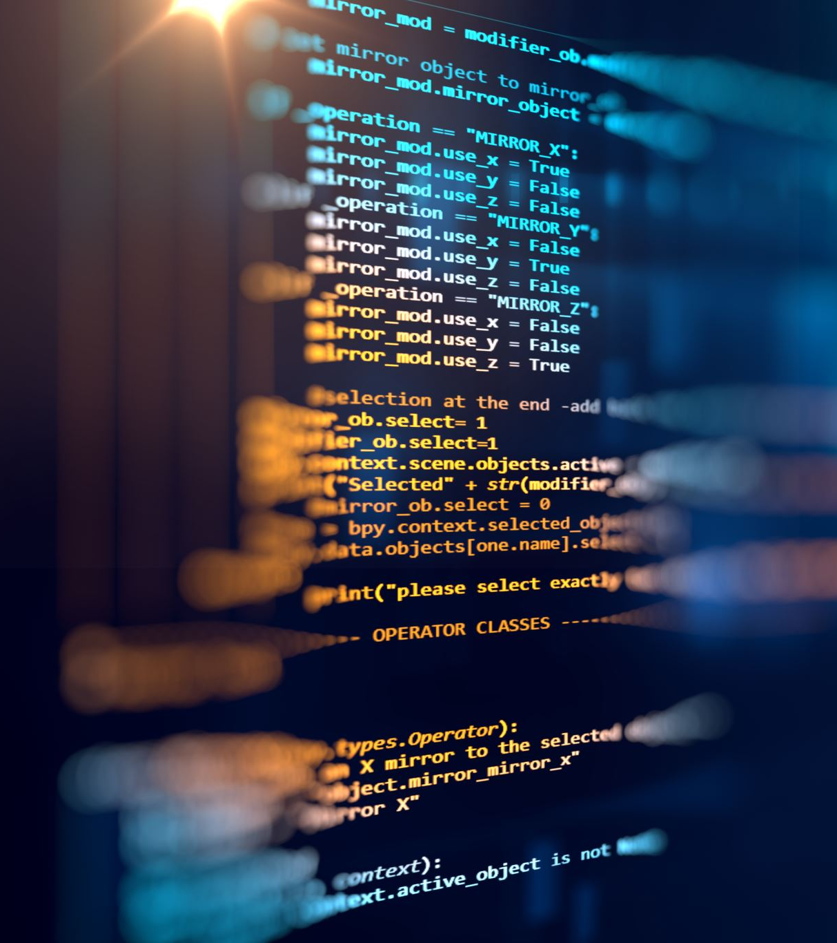
b) Software:
Software refers to the set of programs and instructions that tell the computer what to do.
Two Types of software.
System Software
Application Software

Slide 25
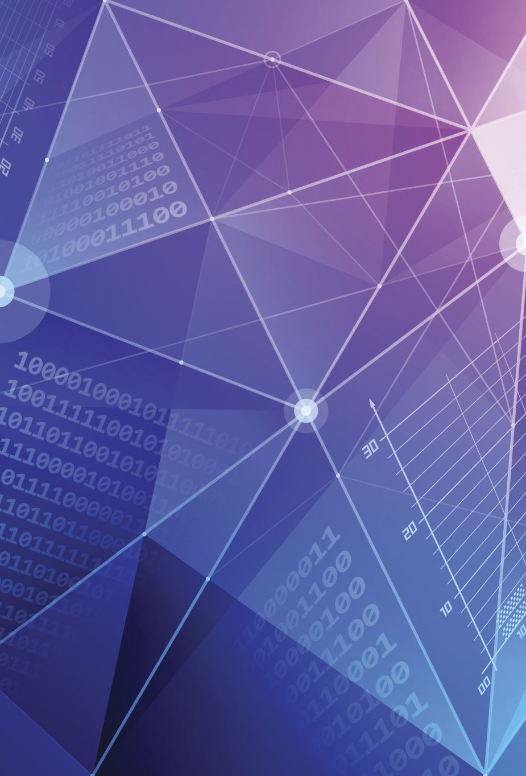
System Software:
Controls and manages the computer system.
Examples:
Windows
Linux
Android

Slide 26
Application Software:
Used for specific tasks.
Examples:
MS Word
Excel
Browser
Gaming App
Two Types of Application Software:
General Purpose
Specific Purpose

Slide 27
General Purpose S/w:
It is used by everyone.
Examples:
MS Word
Google Chrome
VLC Player

Slide 28
Specific Purpose S/w:
Program designed for particular field/job.
Examples:
AUTOCAD for Engineering
KOHA for Libraries.

Slide 29
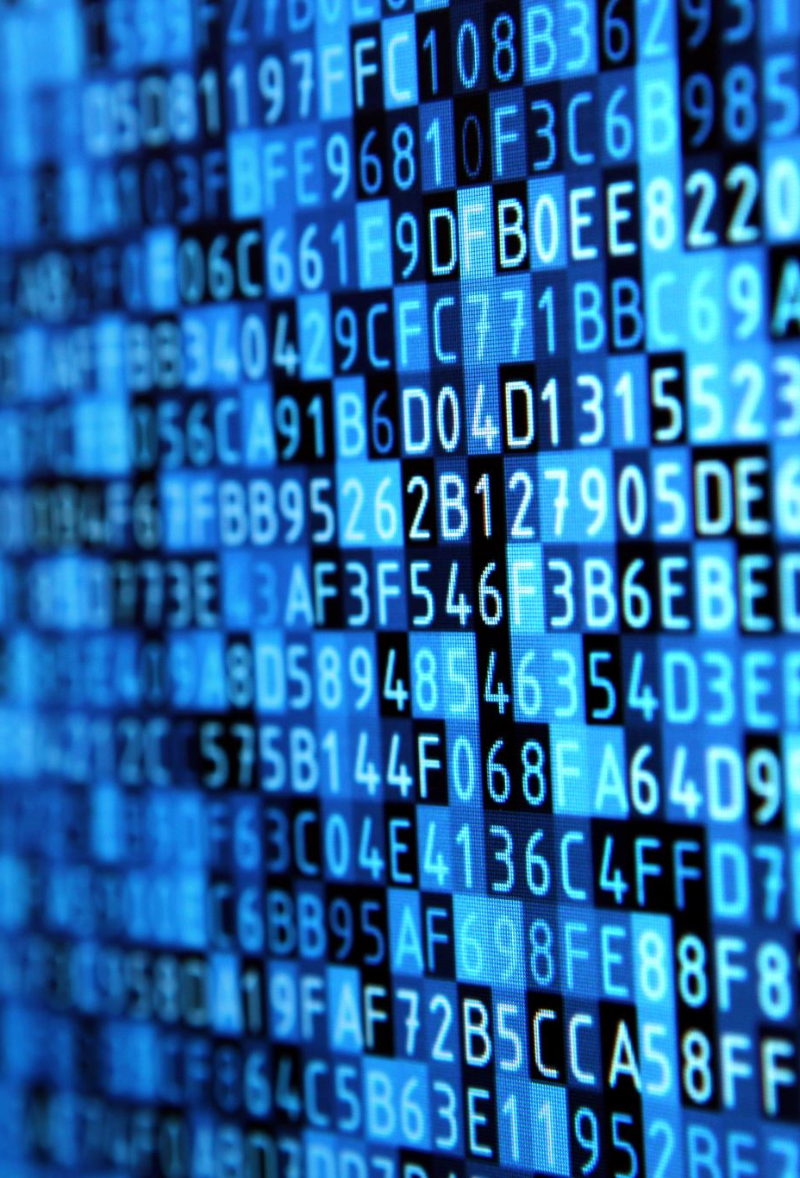
c) Data:
Data refers to raw facts and figures entered into the computer for processing.
Data itself may not have meaning until processed.
Examples of Data
Student names
Marks
Temperature readings

Slide 30
d) Users:
Users are the people who operate and use computers.
Without users:
Computers would have no purpose.

Slide 31
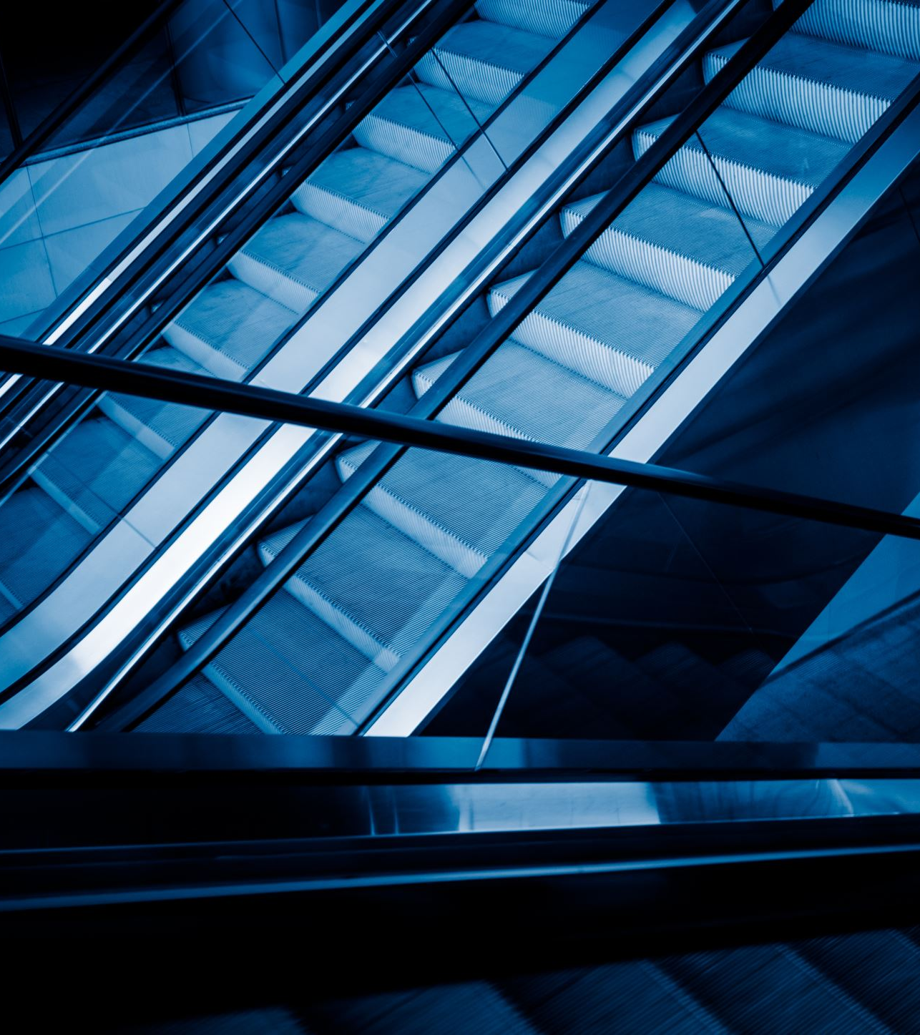
e) Procedures:
Procedures are the rules, steps, or instructions that users follow while operating a computer system.
Examples of Procedures:
Steps to log into a university portal
Procedure for withdrawing money from an ATM

Slide 32
5. Types of Computers
Super-computer
Main-frame Computer
Micro-computer
Mini-computer

Slide 33
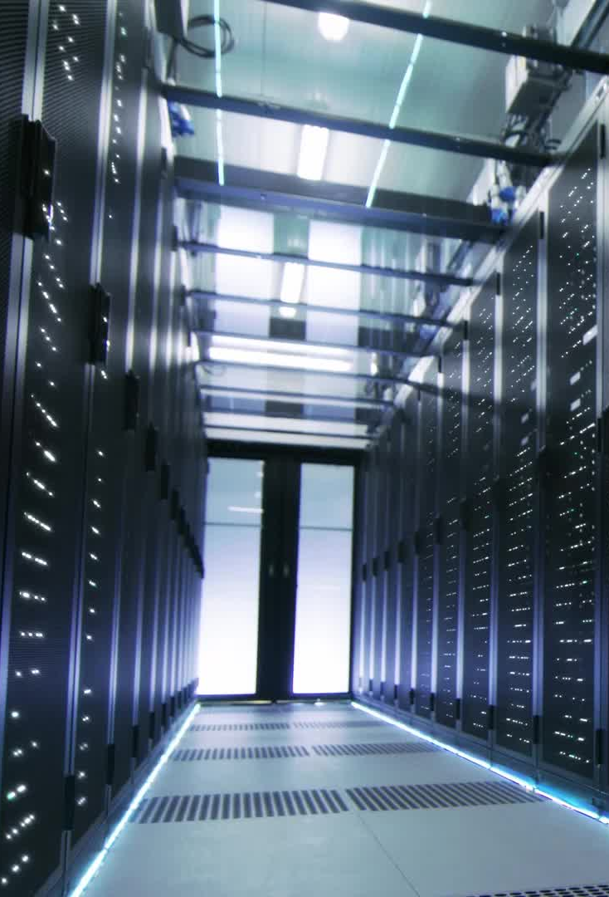
a) Supercomputers
Fastest and most powerful computers
Used for scientific research
Weather forecasting
Space research
Disaster prediction

Slide 34
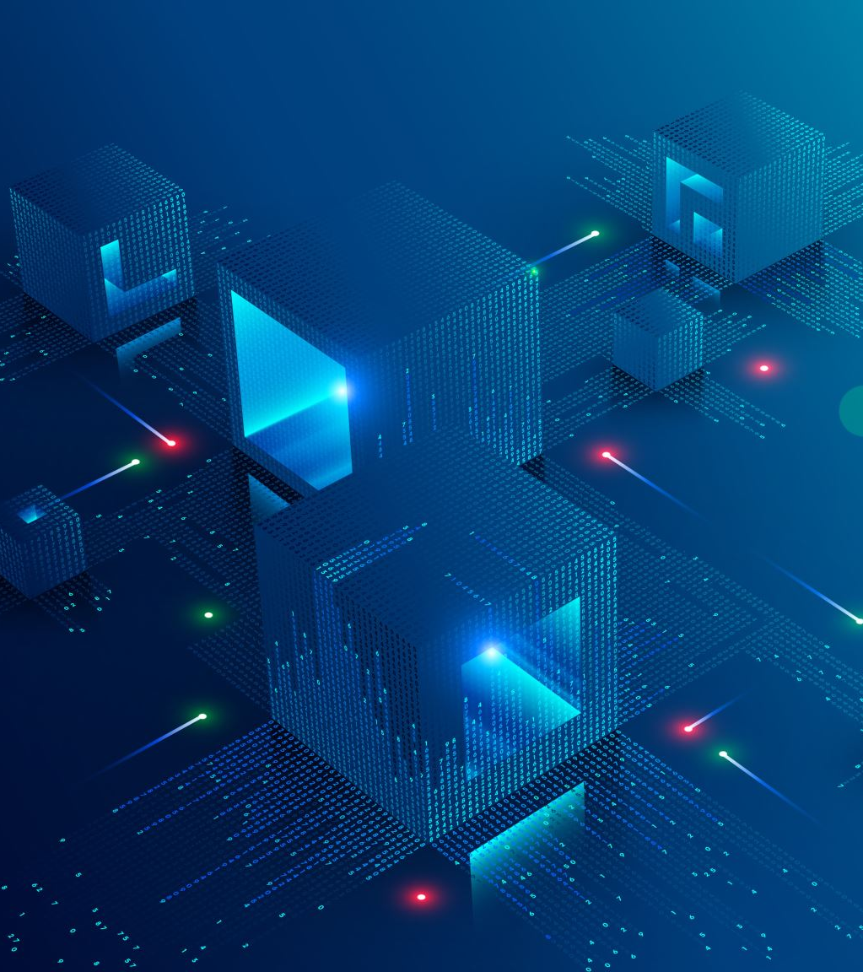
b) Mainframe Computers
Large computers handling massive data
Uses:
Banks
Airlines
Government organizations

Slide 35
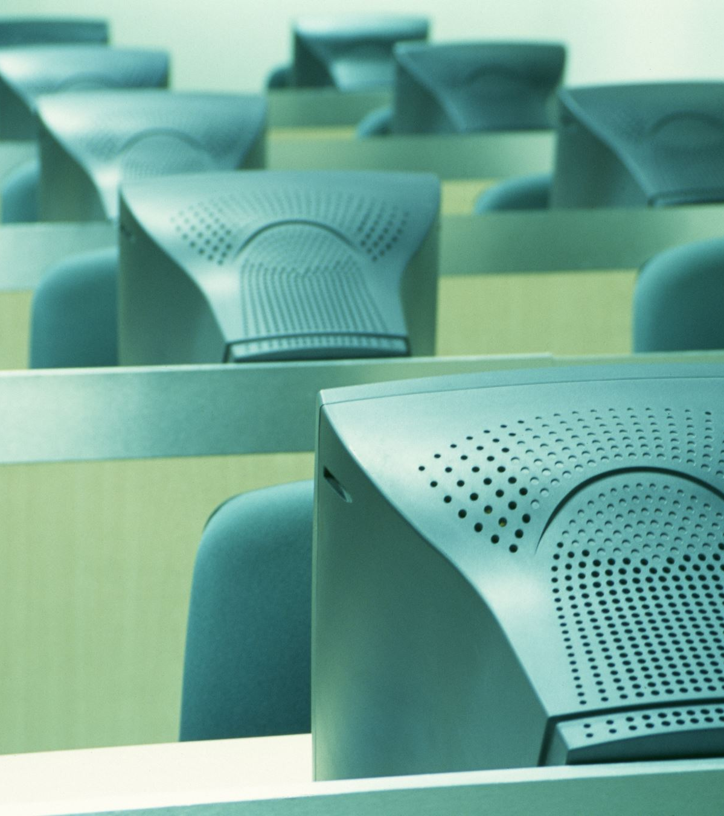
c) Minicomputers
Medium-sized computers
Uses:
In organizations
Hospital Systems

Slide 36
d) Microcomputers (Personal Computers)
Most common computers.
Examples:
Desktop computers
Laptops
Embedded Systems

Slide 37
Key Differences
Super
Mainframe
Mini
Micro
Fastest
Largest
Most Expensive
Scientific Research
E.g. El Capiton, Fugaku
Fast
Large in size
Expensive
Large Org Data
E.g. IBM z15, IBM z16
Faster than Micro
Smaller than Mainframe
Cheaper than Mainframe
Small Business/Lab
E.g. PDP-11
Slowest
Smallest
Cheapest
Personal Work
E.g. Dell, Android Phone

Slide 38
6. Advantages of Computers
Saves time
Increases productivity
Reduces human effort
Improves communication
Helps in research

Slide 39

7. Disadvantages of Computers
Security risks
Cybercrime
Health issues

Slide 40
Homework!
Applications of Computers in…………………!

